Slide 1




2
Robot Programming with ROS2
Instructor:
Erfan Riazati
Fall 2025
Iran University of Science and Technology

Slide 2
WEEK 0
Course Setup

Slide 3




ROS2 Installation
Distribution
ROS2 Humble Hawksbill
Supported OS
Ubuntu Jammy Jellyfish (22.04)
Windows 10 (VS2019), macOS, …
Course Setup
Native/Dual-Boot Ubuntu
Virtual Machine (VMWare Player)
for more information:
ROS2 Humble Documentation Installation
REP2000
WEEK 0 | Course Setup
1

Slide 4


VMware Workstation Pro
Login to the Broadcom Support Portal
After successful login, access the VMware Workstation Pro downloads using the link: Download VMware Workstation Pro (Free)
Expand “VMware Workstation Pro <version> for Windows“
Select the version you want to download under the release column
for more information:
Downloading VMware Workstation Pro
WEEK 0 | Course Setup
01

Slide 5

Grading Scale:
Presence 40%
Homework 60%
+60% to obtain certification
Course Schedule
WEEK 1
WEEK 2
WEEK 3
WEEK 4
Session 1
ROS2 Concepts
Course Setup
ROS Vs. ROS2
ROS2 Design
Publishers and Subscribers
Interfaces and Messages
URDF and Simulation
Build a Visual Robot Model
URDF and Xacro
Gazebo Simulation
Publish Robot States
Use Existing Models
Changing Worlds
Robotic Manipulation
Serial Robot Manipulators
MoveIt2 Introduction
➜ Collisions
➜ Kinematics
➜ APIs
Behavior Trees
Real-World Scenarios
Behavior Tree Tools
Factory Example
Final Project
HW4
Session 2
Review and Examples
Review Basics
Services
Actions
Examples:
➜ Trajectory Control
➜ …
Robot Navigation
Mobile Robots
SLAM Algorithms
Nav2 Introduction
➜ Localization
➜ Planning and Control
Goal Points and Patrolling
Robot Perception and TF
Transform Coordinates
Static Transform
TF Broadcasters
ROS Standards
Robot Vision
Conclusion
Course Summary
Advanced Topics
Future Directions
Available Resources
Opportunities
HW1
HW2
HW3
WEEK 0 | Course Setup
2

Slide 6

Week 1
ROS2 Introduction

Slide 7

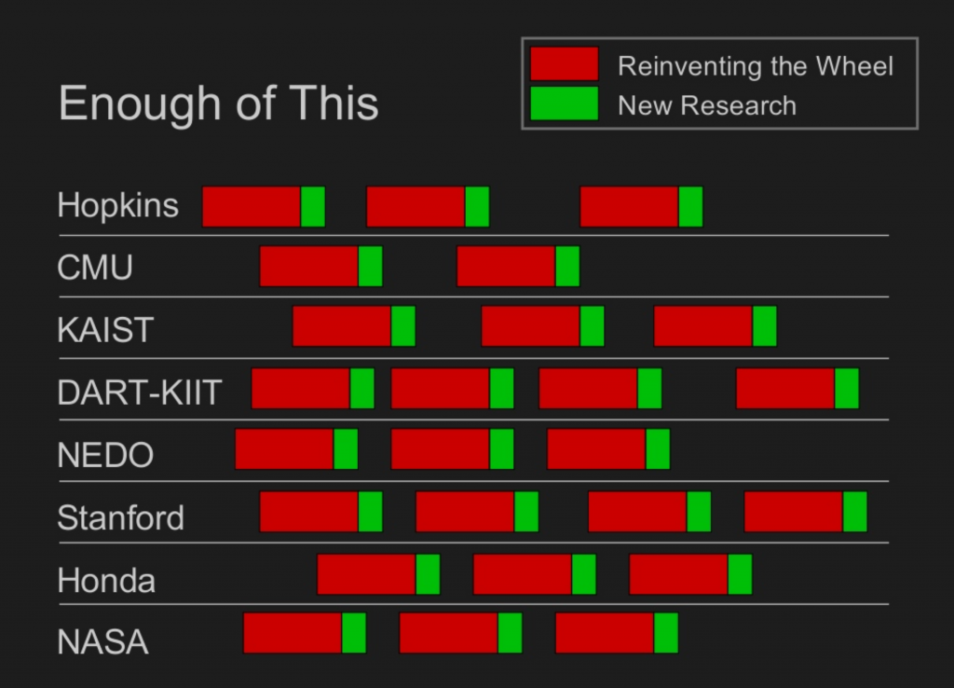
History of ROS
originally developed in 2007 at the Stanford Artificial Intelligence Laboratory
the most common problem in robotics:
excessive time dedicated to re-implementing the software infrastructure
inadequate time allocated to actually building intelligent robotics programs
ROS; a framework that allows processes to communicate with each other and provides some tools to help create code on top of that.
since 2013 managed by Open-Source Robotics
de facto standard for robot programming
Fig. 1. Eric and Keenan pitch deck.
Week 1 | ROS2 Introduction
4

Slide 8
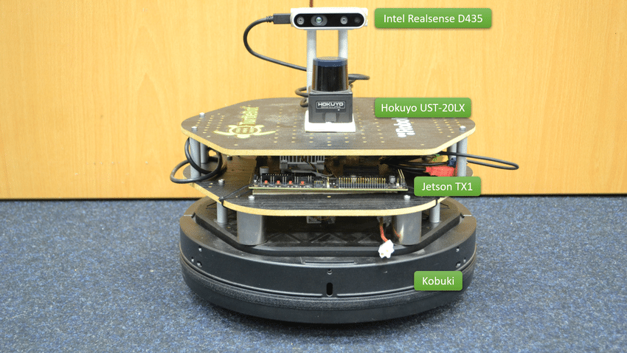
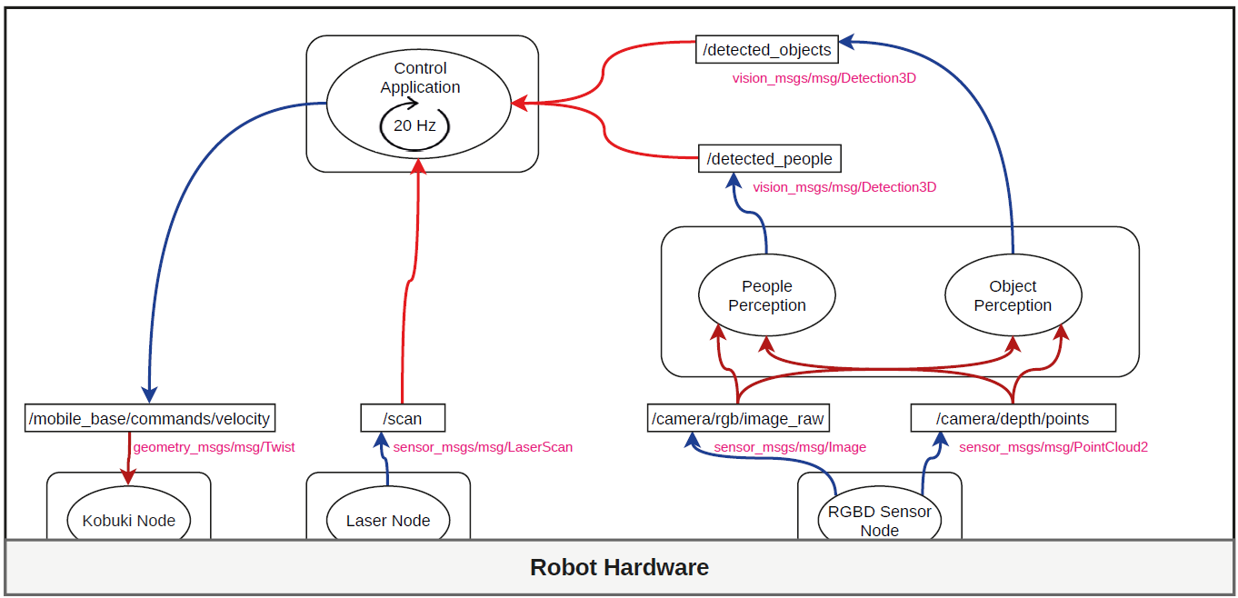
Typical Robotics Modules
Fig. 1. Kobuki Robot.
Fig. 1. Representation of software layers in a robot.
Week 1 | ROS2 Introduction
5

Slide 9

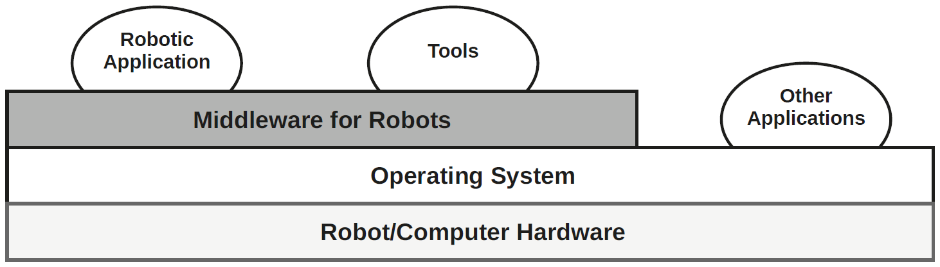
Robotics Software Stack
Fig. 1. Representation of software layers in a robot.
Week 1 | ROS2 Introduction
6

Slide 10
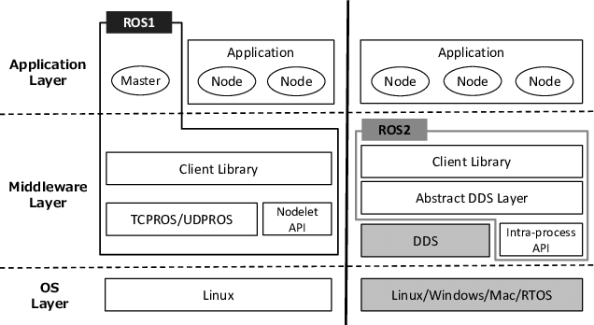
ROS1 vs. ROS2
Middleware:
ROS1 ➜ TCPROS/UDPROS
ROS2 ➜ DDS
Real-Time Support
Quality of Service (QoS)
Security Features
Build System:
ROS1 ➜ catkin
ROS2 ➜ ament
Maintenance:
“ROS1 is DEAD, and we have killed it!”
Many Other Things:
Node Composition, Lifecycle Nodes, …
Fig. 1. ROS1/ROS2 Architecture.
Week 1 | ROS2 Introduction
7

Slide 11
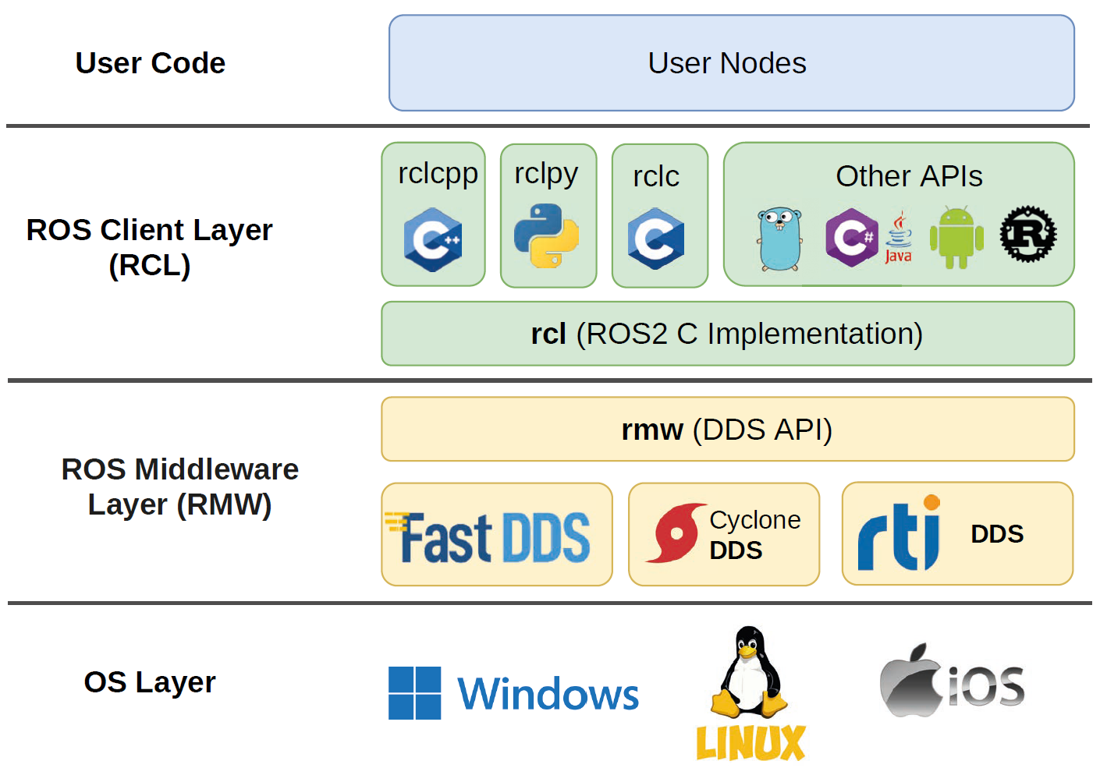
ROS2 Design
Fig. 2. ROS2 layered Design.
Week 1 | ROS2 Introduction
8

Slide 12

WEEK 2
ROS Essentials

Slide 13

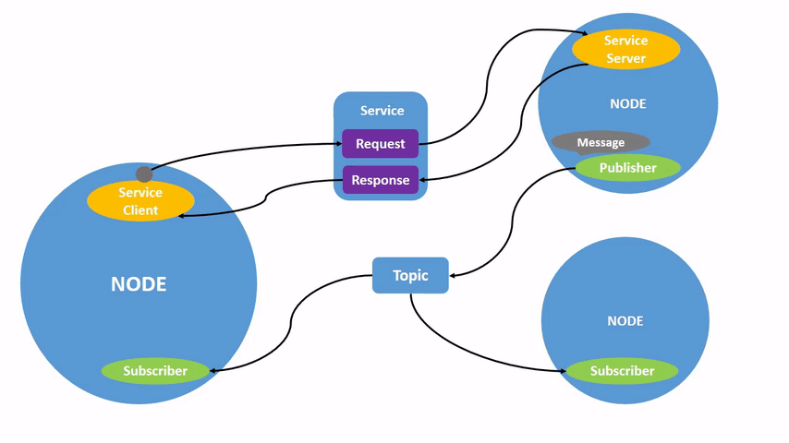
ROS Basics
Services:
Event-based execution using Request-Response Communication
e. g. Taking a Camera Snapshot
Actions:
Generalized Request-Response Non-Blocking Execution
e. g. Autonomous Navigation
Includes:
Goal
Result
Feedback
Nodes:
Software Processes that do things
Usually in C++ and Python
Topics:
Transform Information between Nodes
Organized as Data Structures
Identified by “Name” and “Type”
Publishers/Subscribers:
Use Topics to Communicate
Publishers Generate Information
e. g. Sensors and Actuator Drivers
Subscriber Receive Information
e. g. Monitoring Systems
Week 1 | ROS2 Introduction
10

Slide 14
ROS2 Commands
Setup ROS2 Environment
Before using any ROS 2 command, source the setup file:
To make this automatic every time you open a terminal:
Install Turtelsim (if not already installed)
ROS2 Commands Structure
$ source /opt/ros/humble/setup.bash
$ echo "source /opt/ros/humble/setup.bash" >> ~/.bashrc
$ sudo apt update
$ sudo apt install ros-humble-turtlesim
ROS Packages Installation Structure
$ sudo apt install ros-{$ROS_DISTRO}-{package_name}
$ ros2 <command> <verb> [<params>|<option>]*
Example
$ ros2 run turtlesim turtlesim_node
Week 1 | ROS2 Introduction
11

Slide 15
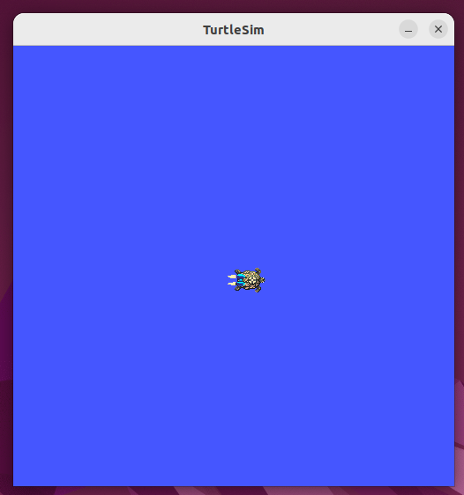
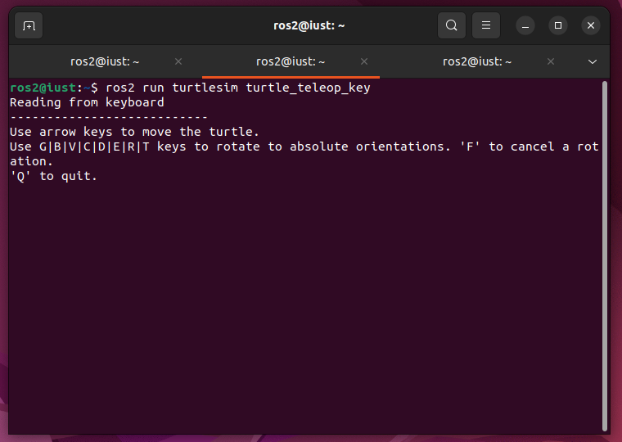
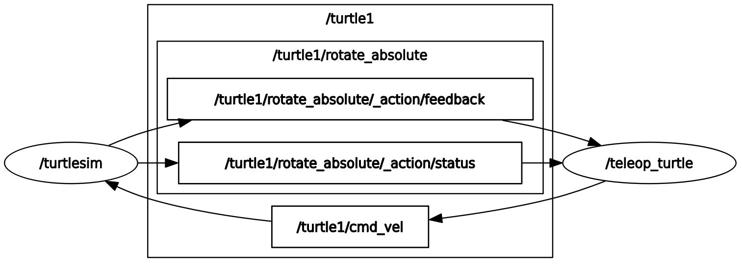
Turtlesim Example
In the first terminal run the following command:
In a new terminal run the following command and use arrow keys to move the turtle:
Witness the computing graph of the current ROS application using rqt:
$ ros2 run turtlesim turtlesim_node
$ ros2 run turtlesim turtle_teleop_key
$ ros2 run rqt_graph rqt_graph
Week 1 | ROS2 Introduction
12

Slide 16
ROS2 Commands Cheat Sheet
$ ros2 node list
Lists all active ROS nodes
$ ros2 node info </node_name>
Information about a specific node
$ ros2 topic list
Lists all active ROS topics
$ ros2 topic list -t
Lists all active ROS topics with their type
$ ros2 topic info </topic_name>
Information about a specific topic
$ ros2 topic echo </topic_name> <topic_type>
Returns messages published on a topic
$ ros2 topic pub </topic_name> <topic_type> <value>
Publishes a message on a topic
$ ros2 topic pub </topic_name> <topic_type> <value> -r <rate>
Publishes a message with a fixed rate
$ ros2 topic pub </topic_name> <topic_type> <value> -1
Publishes a message only once
$ ros2 interface show <message_type>
Shows inside a message type
Week 1 | ROS2 Introduction
13

Slide 17
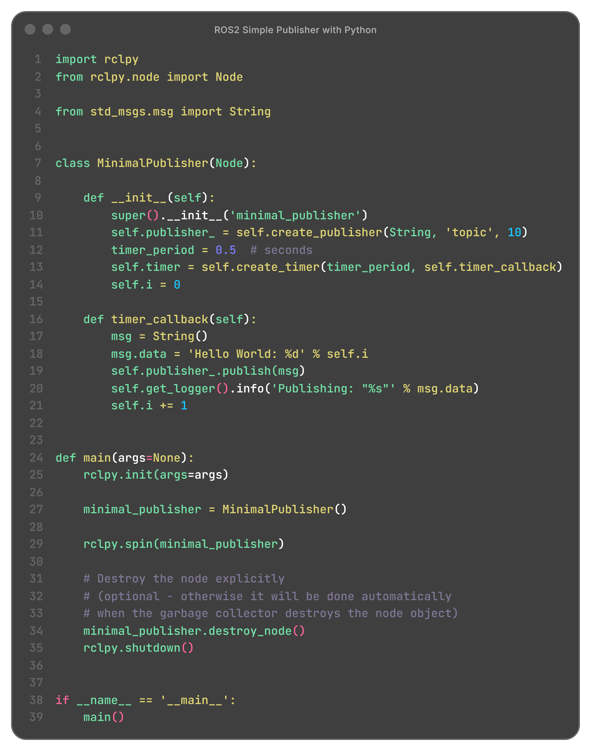
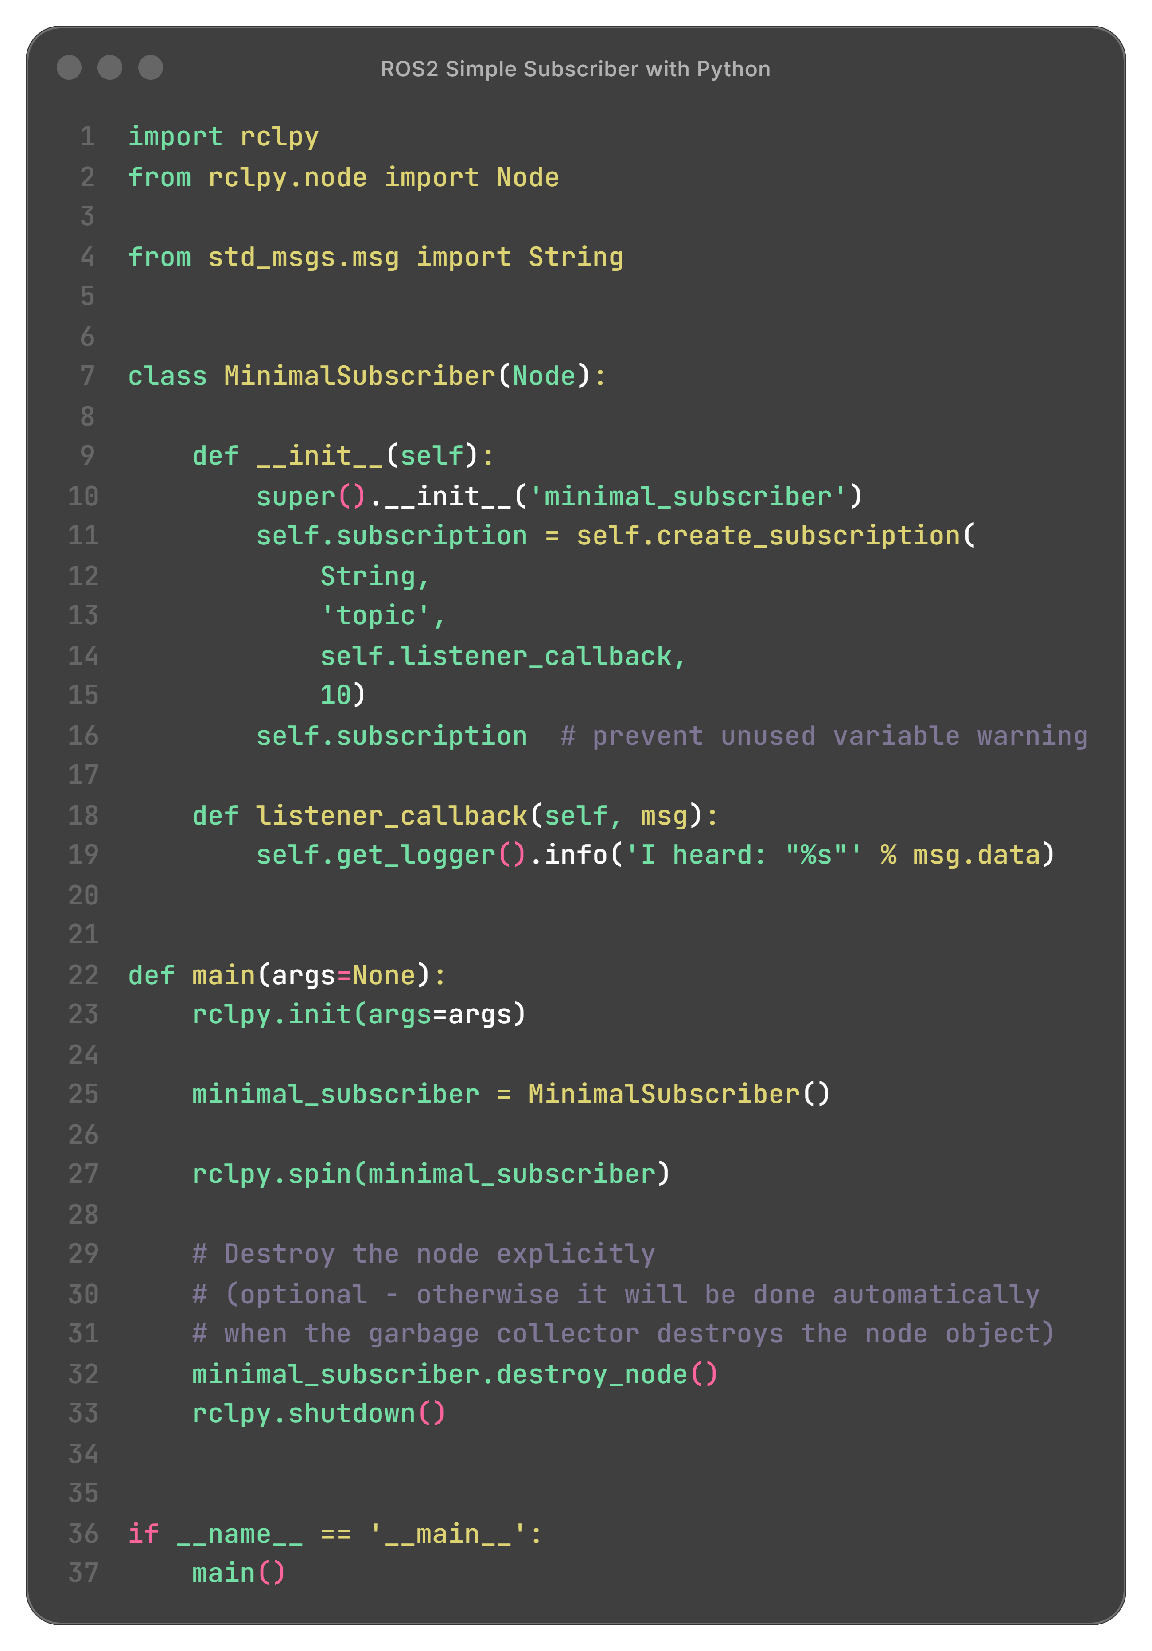
Hello
World!
Let’s write our first publisher and subscriber:
Objective:
Write a ROS Publisher that generate a String message on an arbitrary topic every half a second. On the other side, develop a ROS Subscriber to receive the message
More Information:
ROS2 Tutorial
Week 1 | ROS2 Introduction
14

Slide 18
ROS2 Workspace
Week 1 | ROS2 Introduction
15

Slide 19
ROS2 Packages
Week 1 | ROS2 Introduction
16

Slide 20
References

Slide 21

Black Board
Robot Programming with ROS2
01

